Slide 1
The Basics Strategy A Socioecological Imperative
William Julius Wilson Summer Institute 2024: Transforming Place Through Neighborhood Leadership
Ronald F. Ferguson, PhD
The Basics, Inc. and Harvard Kennedy School
July 11, 2024
What none of us can do alone, all of us can do together.

Slide 2
The Imperative

Slide 3
Large Disparities @ 24 Months
Between Parental Education Groups
Age: 9 to 12 Months
Age: 24 Months
PARENTAL EDUCATION:
Source: Calculations using the federal Early Childhood Longitudinal Study, Birth Cohort, children born in 2001-2002.
By the Achievement Gap Initiative at Harvard University, 2015.

Slide 4
Large Disparities @ 24 Months
Between Racial/Ethnic Groups
Age: 9 to 12 Months
Age: 24 Months
RACE/ETHNICITY:
Source: Calculations using the federal Early Childhood Longitudinal Study, Birth Cohort, children born in 2001-2002.
By the Achievement Gap Initiative at Harvard University, 2015.

Slide 5
COLLECTIVE INTENTIONALITY
What none of us can do alone,
all of us can do together.

Slide 6
WE WANT ALL CHILDREN TO:
Feel emotionally secure
Have strong communication skills
Build quantitative reasoning skills
Be energetic, playful and curious
Love reading and sharing ideas

Slide 7
THE BASICS PRINCIPLES
Maximize Love, Manage Stress
Talk, Sing, and Point
Count, Group, and Compare
Explore Through Movement & Play
Read and Discuss Stories

Slide 8
THE BASICS BOSTON ALLIANCE CYCLE

Slide 9
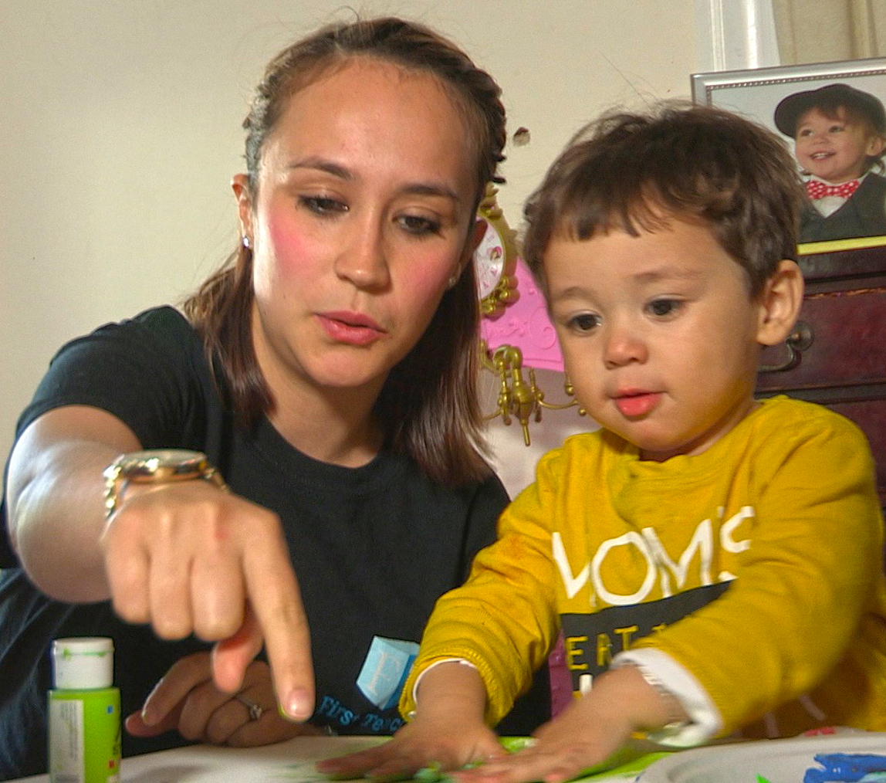
BASICS MOMENTS
For Spreading Information, Encouragement, and Reminders, to Make The Basics Principles Daily Routines
PARENTS ENGAGE & LEARN
FAMILIES INCORPORATE
The Basics Principles
into Daily Routines
CHILDREN THRIVE
In School and Life
With Service Providers
With Parent Partners as Peers
At Community Events/Spaces
Basics Insights Text Messages
Social Media
Print Media (e.g., posters, billboards, handouts)
Zoom Meetings & Webinars

Slide 10
How Frontline Providers Sharing The Basics Principles
N=302 Survey Respondents, Spring 2024

Slide 11
Scaling with Local Networks
Libraries
WIC
ABCD
Head
Start
Public Housing
Faith
Based
Healthcare
Hospitals
Health Centers
Priv. Offices

Slide 12
Scaling with Local Networks
Libraries
WIC
ABCD
Head
Start
Public Housing
Faith
Based
TRUSTED MESSENGERS:
Parent Leadership
Healthcare
Hospitals
Health Centers
Priv. Offices
TRUSTED MESSENGERS:
Frontline Providers

Slide 13
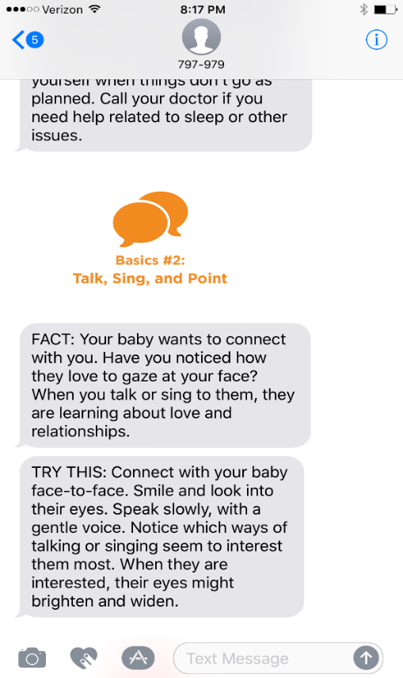
Basics Moments happen when a parent
receives BASICS INSIGHTS TEXT MESSAGES.
Content based on child’s age, from birth to the 5th birthday
One of The Basics Principles is covered each week with two messages, a FACT and a TRY THIS
Aligned with key frameworks including Head Start Early Learning Outcomes Framework
Intended to support ongoing conversations
Can accommodate supplemental messaging to fit local needs

Slide 14
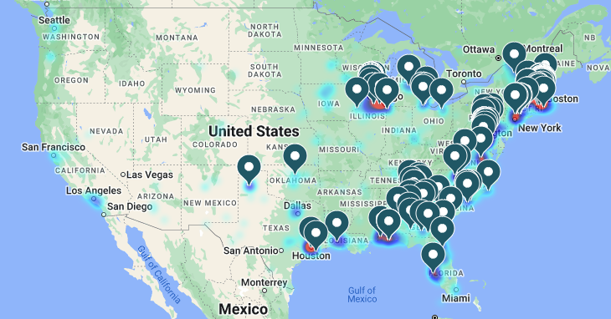
21,415 total users

Slide 15
Cognitive Skills
Social-Emotional Skills
Standard Deviation Units
Standard Deviation Units
17% increment
over normal
growth
43% increment
over normal
growth
Normal
growth
Normal
growth
Age in Months
N=745
Age in Months
N=745

Slide 16
Cognitive Skills
N=1128

Slide 17
Social and Emotional Skills
N=1128

Slide 18
Child Takes Initiative to Read
N=1128

Slide 19
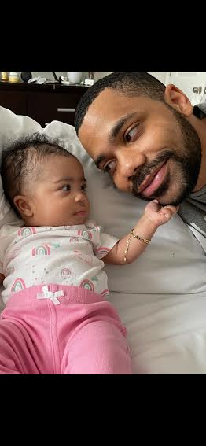
Open responses from Basics Insights text message users.
Love the Messages. They have been very helpful and I have learnt so much from them. I have recommended these to others as well. Keep them coming!
The activities and tasks shared are very practical and easy to implement throughout the day with your child.
These text messages give me a lot to think and research about and implement with my child. Thank you.
This is my second grandson I have used it with. Invaluable!!!
We love it! This wasn't offered to us with my older children so we have really enjoyed it with our youngest.
You guys are a God given help. Everything is insightful, meaningful, and clear. Thank you so much for helping a first-time mom go through the rides of child development. Please continue to bless me with your tools & knowledge. Forever grateful.
I enjoy the texts and how often I receive them. It’s not overbearing or annoying, it’s the perfect cadence. Keeps me thinking and interactive.
Love it! Soooooo helpful!!!
I love Basics, it’s informative, gives great ideas and helps me understand and help my little one. Because as a parent you might feel we are doing things wrong since parenting didn’t come with a manual. So I look forward to my weekly text to try anything new to me that I’ve read.
I find them to be very helpful and a reminder that I am doing the right things with my children.

Slide 20
How I Do The Basics
with My Children
Let them know every day that I love them.
That includes when I’m tired and stressed.
Yes, we talk, sing, and point as we go back-and-forth,
Having fun with the thoughts we express.
We count fingers and toes and put objects in groups,
And we find lots of things to compare.
We explore while we play and discover new things
And we do it almost everywhere.
We read stories in books and discuss what we think,
And sometimes what the books make us feel.
Yes, The Basics are things that we do every day,
As a fun way to make our dreams real.

