Slide 1

Overcoming Barriers to Collaboration
Change at the Speed of Trust – The Case of Louisville, KY
Jorrit de Jong
Director, Bloomberg Center for Cities at Harvard University
Emma Bloomberg Senior Lecturer in Public Policy and Management, Harvard Kennedy School
Notes:
Title Slide v1

Slide 2
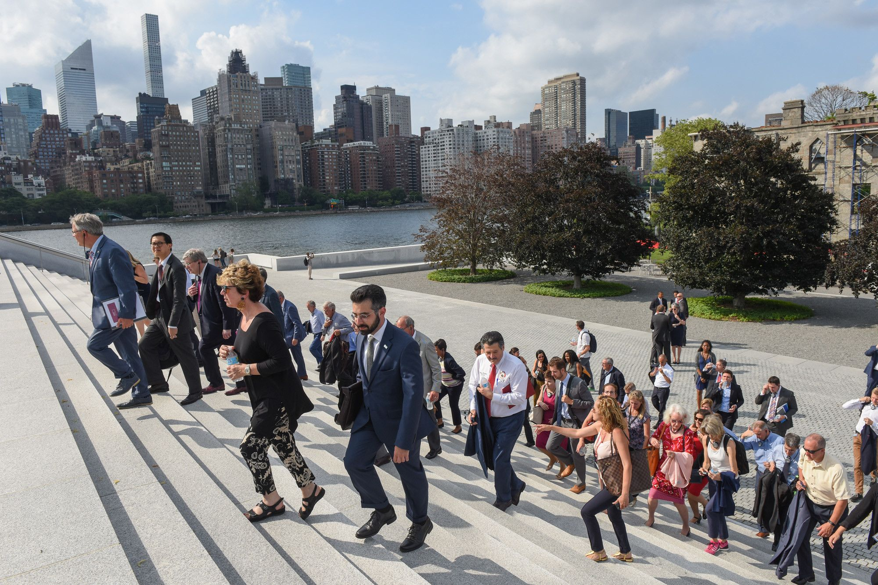
Every city is unique
Notes:
We have an executive education program for mayors, ______ have gone through it.

Slide 3
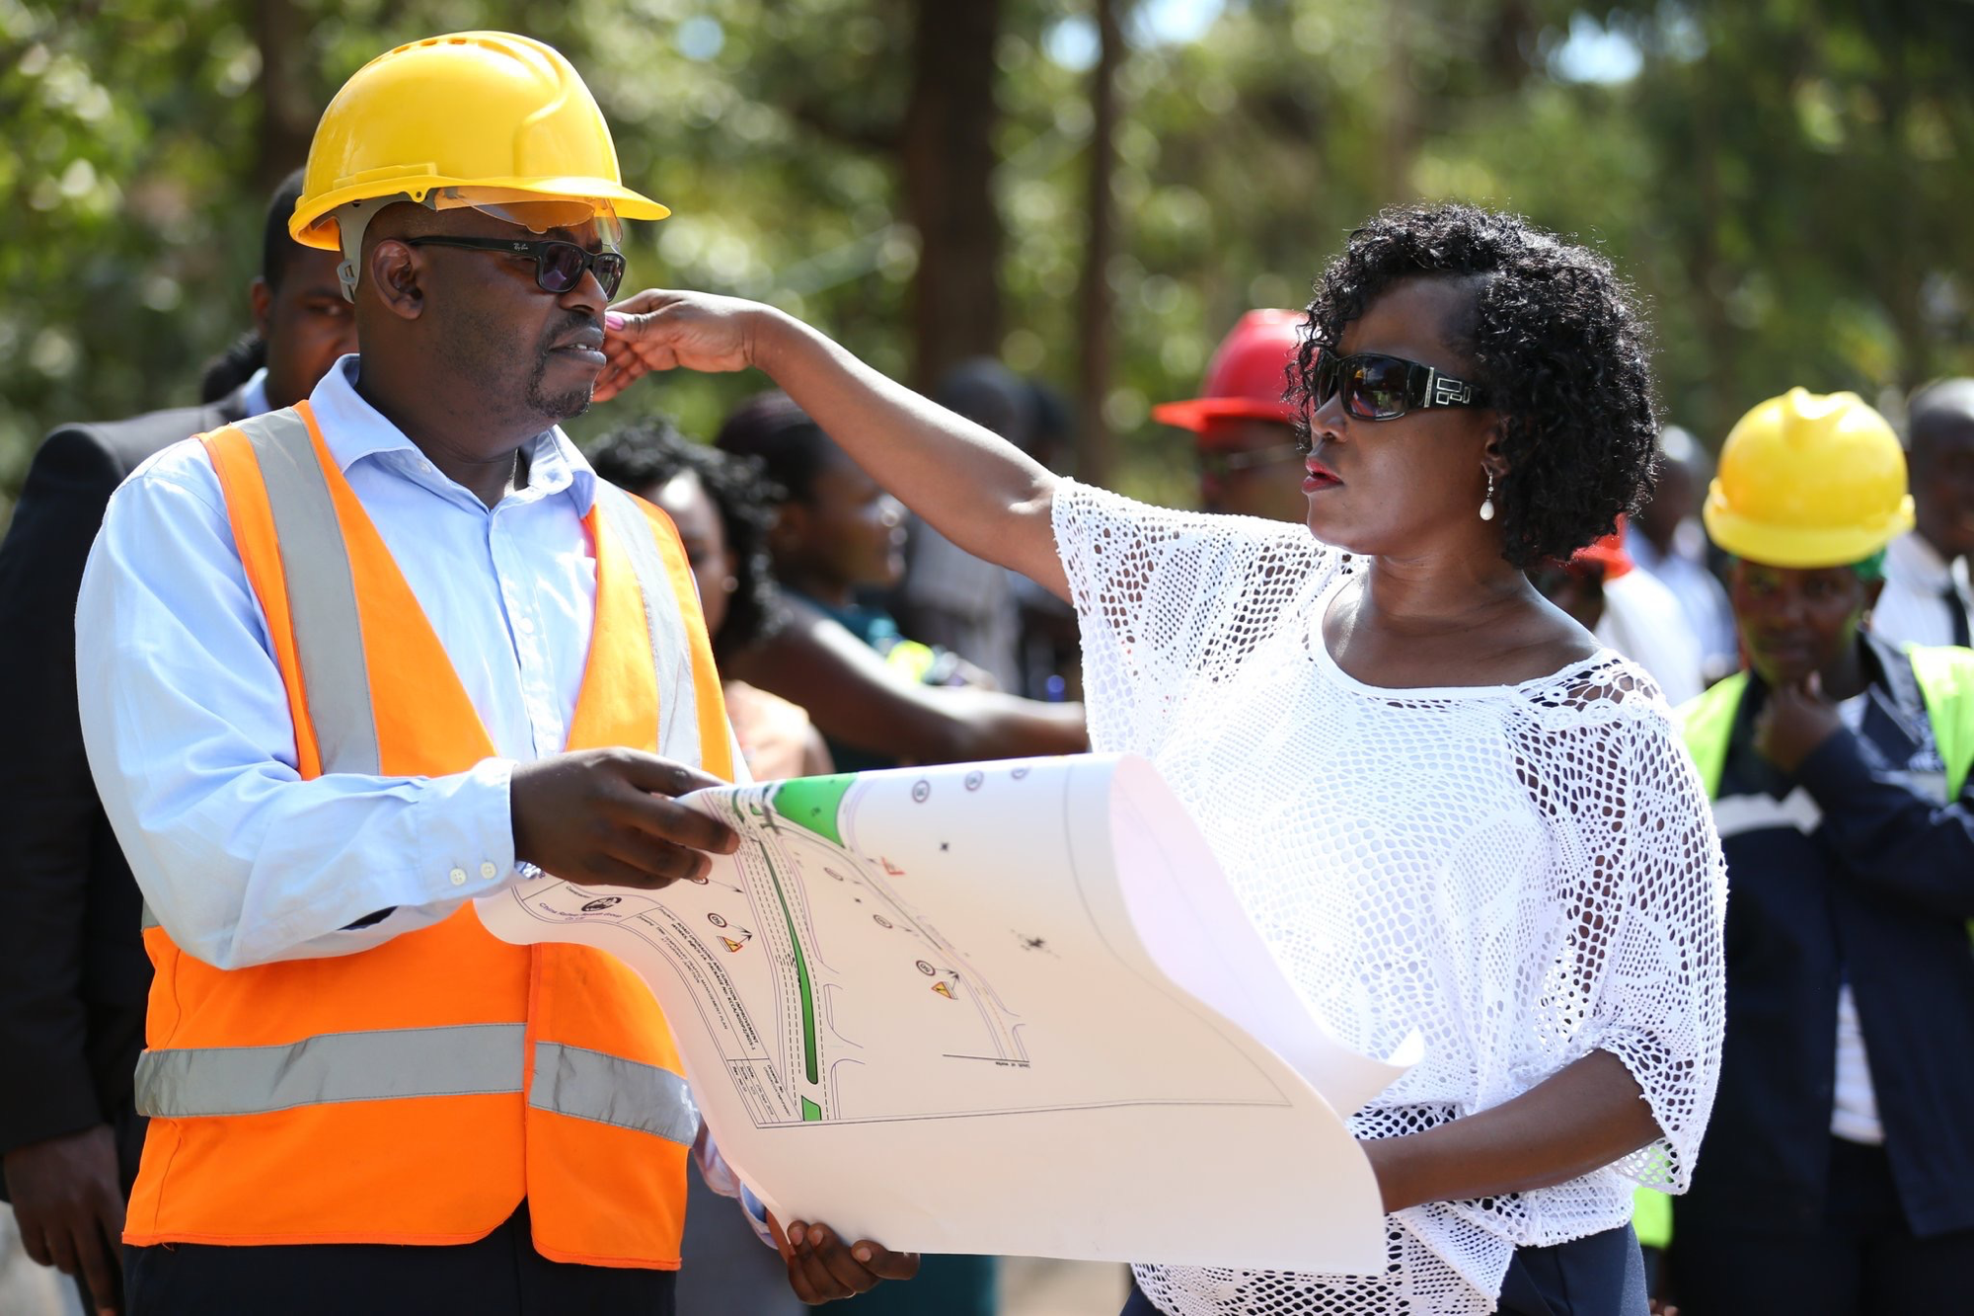
Yet, all city leaders face similar challenges
Notes:
Mayors have a community facing job and a organization facing job. We will speak about the latter today

Slide 4

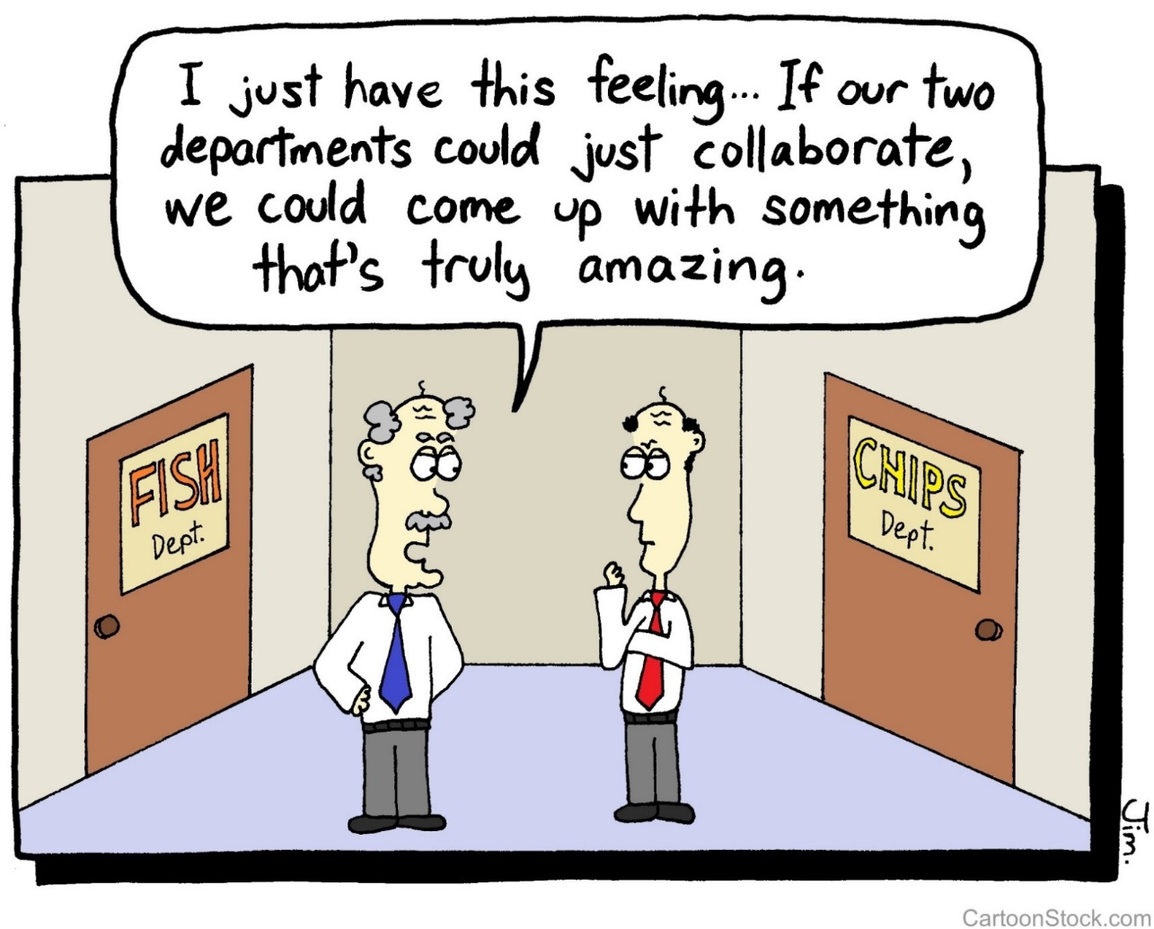
Notes:
Content Slide v1

Slide 5
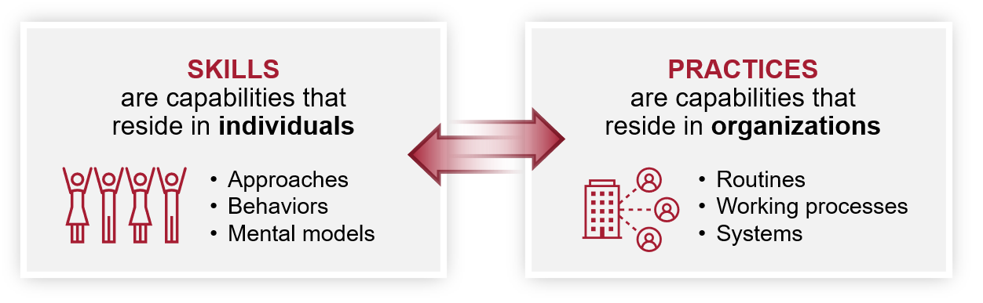
Capabilities for Cross- Sector Collaboration
Notes:
Capabilities are skills (individual) and practices (organizational)
Language from R&C overview:
Our work builds off the paper “State Capabilities for Problem-Oriented Governance,” which outlined essential capabilities that empower public sector organizations, like cities, to be more responsive to challenges. Strategic leadership and management encapsulates a range of leadership capacities that mayors, senior city leaders, and others in city hall need to deliver for their city’s residents. The three other capabilities – data and evidence, innovation, and collaboration – provide the foundation for the Initiative’s flagship programming tracks.
These capabilities include both skills that individuals exhibit (such as approaches or behaviors) and practices that organizations operate (such as routines, working processes, or systems). In all of our work, there are skills that an individual will develop through the course of their learning, and there are organization-wide practices that need to develop for cities to sustain effective, efficient, and equitable governance.

Slide 6
Goals for this session
Examine common barriers to cross-sector collaboration
Introduce research-based insights and diagnostic tools
Discuss strategic challenges in your context
Hear the “lessons learnt” from two Louisville leaders
Notes:
Content Slide v1

Slide 7
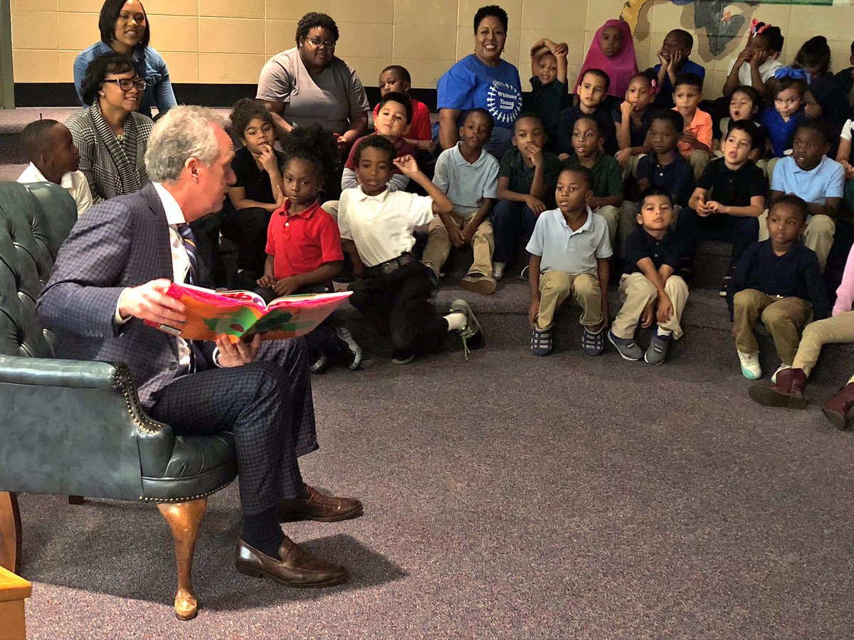
Change at the Speed of Trust
Advancing Educational Opportunity through Cross-Sector Collaboration in Louisville, KY

Slide 8
“The nature of these collective models is not speed. What kind of leadership do you bring to these massive collective impact models? Most of them fail, it seems to me, as I look at them around the country.
A lot of progress has been made about the vision and what we want. But then people start turning over and you bring in new people…. So, you’re getting consensus on something that there was consensus about two years ago.
I find myself wondering, ‘Are we not moving fast enough or is it just me?’”
—Mayor Greg Fischer

Slide 9

Was this collaboration moving at the right speed?
1. Yes, it is moving at the right speed
2. No, it should slow down to be truly successful in the end
3. No, it should move faster to produce results for students now
Notes:
Content Slide v1

Slide 10











Brent McKim
Teachers
Association
Mason Rummel
JG Brown Foundation
Mary Gwen Wheeler
55,000 Degrees
Tony
Zipple
Centerstone
Brent McKim
Teachers Association
Mason Rummel
JG Brown Foundation
Mary Gwen Wheeler
55,000 Degrees
Supt. Donna Hargens
Public Schools
Tony
Peyton
C.E.&S. Foundation
Supt. Marty
Polio
Public
Schools
Tony
Zipple
Centerstone
Cradle
to Career
Cabinet
SUMMER 2016
COLOR KEY
(with total members by iteration)
Louisville Promise Cabinet
SPRING 2017
Jonathan Lowe
Public Schools
Joe
Tolan
Metro United Way
Deja Jackson
Matt Berry
Alan Young
Emma Horn
Chris
Brady
Board of Education
CORE
TEAM
Tony
Peyton
C.E.& S. Foundation
David
Jones Jr.
Board of Education
Amy
Neal
Metro United Way
Amy
Neal
Non-Profit/ Voluntary Sector (10,9)
Jonathan Lowe
Lisa
Willner
Board of Education
Theresa Reno-Weber
Metro United Way
Private Sector (1,1)
Mayor
Greg Fischer
Metro Gov
Angie
Ditsler
Metro United
Way
Higher Education (3,5)
Ashley Parrott
Denise Nelson
Weiss Institute
City Government (6,1)
Mayor
Greg Fischer
Metro Gov
Karen Wunderlin
Consultant
Jennie Jean Davidson Better Together Strat.
Ben
Reno-Weber
Greater Louisville Project
Eric Friedlander
Metro Gov
Ben
Reno-Weber
Greater Louisville Project
Public School System (4,4)
Frank
Smith
Simmons College of KY
Kent
Oyler
Greater
Louisville Inc.
Rashaad Abdur-Rahman
Metro Gov
Kent
Oyler
Greater
Louisville Inc.
Kevin Cosby
Simmons College of KY
Audwin Helton
15,000
Degrees
Katie Dallinger
Metro Gov
Sadiqa Reynolds
Urban League
Ty
Handy
Jefferson Community and Tech. College
Sadiqa Reynolds
Urban League
Ashley
Parrott
Metro Gov
Yvette Gentry
Metro Gov
Ty
Handy
Jefferson Community and Tech. College
Neville
Pinto
U of Louisville
Tori Murden McClure
Spalding U
Jim
Allen
JCPS
Foundation
Ralph Fitzpatrick
U of Louisville
Tori Murden McClure
Spalding U
Michael Gritton
Kentucklana Works
Notes:
Content Slide v1

Slide 11









Brent McKim
Teachers Association
Mason Rummel
JG Brown Foundation
Mary
Gwen
Wheeler
55K Degrees
Louisville Promise Cabinet
SPRING 2018
John Marshall
Public
Schools
Tony
Zipple
Centerstone
COLOR KEY
(with total members for cabinet and committees, top to bottom)
Brent McKim
Teachers Association
Diane Porter
Board of Education
Lisa
Willner
Board of Education
Ralph Fitzpatrick
U of Louisville
Mary
Gwen Wheeler
55K Degrees
Louisville Promise Cabinet
SPRING 2018
Tony
Peyton
C.E.&S. Foundation
Supt. Marty
Polio
Public
Schools
Jonathan Lowe
Deja Jackson
Denise Nelson
Weiss Institute
Karen Wunderlin
Consultant
Governance ad hoc Committee
Admin
Team
(Meets Weekly)
Jonathan Lowe
Public Schools
Mason Rummel
JG Brown Foundation
Mayor Greg Fischer
Metro Gov
Ashley Parrott
Tony
Peyton
C.E.&S. Foundation
Non-Profit/
Voluntary Sector
(10,6,6,0)
Susan Barry
Community Foundation of Louisville
Matthew McCreight
Weiss Institute
Mary Anne Schmitt- Corey
Weiss Institute
Audwin Helton
15,000
Degrees
Tony
Zipple
Centerstone
Private Sector
(1,0,1,0)
Vincent James
Metro Gov
Theresa Reno-Weber
Metro United Way
Higher Education
(4, 1,1,5)
Ashley Parrott
Metro Gov
Sam Corbett
Future Up
Theresa Reno-Weber
Metro United Way
Mary
Gwen
Wheeler
55K Degrees
Emma
Hom
55K Degrees
City Government
(2,0,1,3)
Fundraising ad hoc Committee
Lisa
Willner
Board of Education
Ben
Reno-Weber
Greater Louisville Project
Public School System
(5,4,0,3)
Consultant
(1,2,1,2)
Ty Handy
Jefferson Community & Tech College
Michael Gritton
Kentuckiana Works
Denise Nelson
Weiss Institute
Alice Houston
15,000
Degrees
Kent
Oyler
Greater
Louisville Inc.
Diane Porter
Board of Education
Kent
Oyler
Greater
Louisville Inc.
Supt. Marty
Polio
Public
Schools
Mayor Greg Fischer
Metro Gov
Ashley
Parrott
Metro Gov
Vincent James
Metro Gov
Ellen Grant
Weiss Institute
Frank
Smith
Simmons College of KY
Audwin Helton
15,000
Degrees
John Marshall
Public
Schools
Search ad hoc
Committee
Karen
Wunderlin
Consultant
Ty Handy
Jefferson Community and Tech. College
Alice Houston
15,000
Degrees
Marco Munoz
Public
Schools
Edgardo Marsilla
Americana World Community Center
Tori Murden McClure
Spalding U
Spalding University HR Rep
Armon Perry
U of Louisville
Mary Nixon
U of Louisville
Ralph Fitzpatrick
U of Louisville
Tori Murden McClure
Spalding U
Michael Gritton
Kentucklana Works
Sadiqa Reynolds
Urban League
Notes:
Content Slide v1

Slide 12
Trade-Offs in Cross-Sector Collaboration
Quality
Robustness of your collaborative
Approach to solving the problem
Consensus
Inclusion of stakeholders needed to produce desired outcomes
Speed
Making progress fast enough to deliver results in time
Notes:
Content Slide v1

Slide 13
Creating Public Value: The Strategic Triangle
An Agent of Change Working to imagine opportunity, secure support, and mobilize resources to deliver results.
Legitimacy
& Support
Public Value
Coalition
Operational
Capacity
Source: Mark H. Moore (2013), Recognizing Public Value,
Harvard University Press, adapted by authors
Notes:
Content Slide v1

Slide 14
Top 3 Challenges for Cross-Sector Collaborations
Teaming Building trust, mutual understanding and a way to communicate and decide together.
Legitimacy
& Support
Accountability Navigating competing commitments between collaboration and parent organizations
Coalition
Public Value
Operational
Capacity
Substance Agreeing on problem definition, solutions, and course of action
Groenleer, M., J. De Jong, M. Waardenburg and B. Keijser “Paradoxes in Collaborative Governance,” Public Management Review (2019)
Notes:
Content Slide v1

Slide 15
Are You moving at the Right Pace?
Are you making trade-offs in your collaborative process?
What are your primary barriers to collaboration?
Reflect briefly, then talk to your neighbor, then switch.
Quality
Robustness of your
collaborative approach
to solving the problem
Consensus
Inclusion of stakeholders needed to produce desired outcomes
Speed
Making progress fast enough to deliver results in time
Notes:
Content Slide v1

Slide 16
Check-List for a Cross-Boundary Collaboration
  Engage allies, opponents and fence-sitters
  Secure the required mandate and resources
Legitimacy
& Support
  Agree (enough) on what the problem is
  Agree (enough) on what we’re trying to accomplish
  Agree on measures of success
Public Value
Coalition
  Agree on how to get to success
  Develop a coherent and workable plan
  Decide on how the collaboration will learn and adjust
Operational
Capacity
  Involve the right leaders
  Build trust and mutual understanding
  Develop communication and work processes
  Decide on decision rules and initial governance
De Jong et. al (2021) “Building Cities’ Collaborative Muscle”, Stanford Social Innovation Review
Notes:
Content Slide v1

Slide 17
So…What happened in Louisville?
2020:
40,000 degrees added in ten years (goal was 55,000)
46% of Louisvillians hold a degree (an increase of 8% points since 2010)
But…
Kentucky is spending $2,792 less per student than ten years ago
Fewer public school graduates go to college (9% decrease over ten years)
Enormous gap between Black and white students persists.
Notes:
Content Slide v1

Slide 18
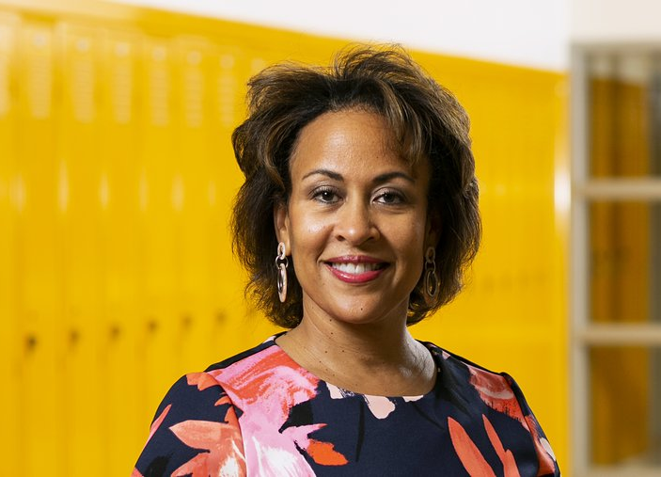
New Executive Director:
Marland Cole
New Name:
Evolve502
Notes:
Enter Marland Cole. Daughter of a school teacher and a JCPS parent. She was serving as the assistant vice president for governance and board support at a Louisville hospital called Baptist Health. Prior to that had been vice president of institutional advancement at Simmons College of Kentucky, a small historically Black private liberal college. Lots of knowledge of systems, process management, board relationships, but an outsider to the politics and bureaucracy of K-12 education. Hired October 2018. Started with three 55k staffers, one already preparing to leave, and three years of operating funds, working out of an office borrowed from an employee on maternity leave at the community foundation of Louisville (fiscal sponsor). The partners were still working with the Weiss institute. Pressure was on to raise funds and get scholarships off the ground.

Slide 19

Why We Do It
Our goal is to ensure an educated, growing and vibrant community in which all citizens can prosper and contribute to the economic vitality of our city.
Systems
We use data and best practices to identify gaps in student achievement and success.
Scholarships
We raise funds so every eligible JCPS graduate can get a tuition-free, two-year college degree or workforce training. The neediest also receive opportunity grants to defray other costs associated with higher education.
Supports
We convene and collaborate with partner agencies in government, education and social services, offering services aimed at ensuring every child in our community has the guidance and tools to succeed.
Notes:
While early emphasis was on scholarships, the Mayor and other board members wanted to ensure that the community understood the collaboration was about more than the promise scholarships for JCPS students. Didn’t want to lose comprehensive services focus. The partners rebranded the initiative and the new 501c3 as Evolve502 (502 is a common Louisville area code)

Slide 20
Timeline
2018
2019
2020
2021
2022
Becoming Evolve502
Building the Organization and the Endowment
Launching Scholarships and Community Learning Hubs
Expansion of programming, scholarships
Further expansion of programming, scholarships
Marland Cole starts as Executive Director in October.
Mary Nixon Chair scholarship board
Audwin Helton Chair Evolve502 board
Dr. Charles Davis Chief Comprehensive Services Officer
Pandemic relief education funds are entrusted to Evolve502
Community Learning Hubs are established to support out-of-school learning during the pandemic
Class of 2021graduates guaranteed two years of tuition-free college, opportunity grants available for neediest
All JCPS high school students eligible for scholarships
University of Louisville promises two additional years tuition free for low-income students
Tutoring program launched in Community Learning Hubs
Raising endowment funds to cover middle school students
Notes:
Content Slide v1

Slide 21
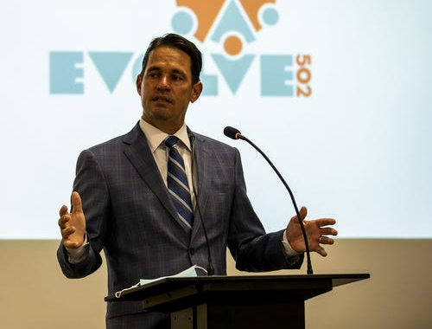
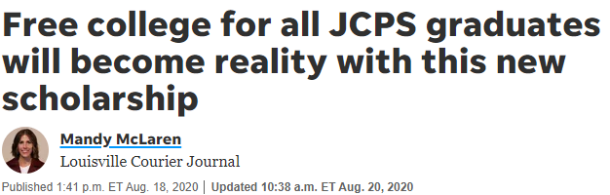
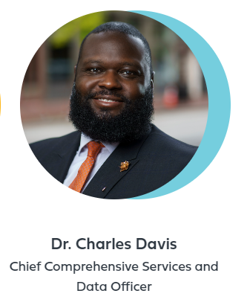
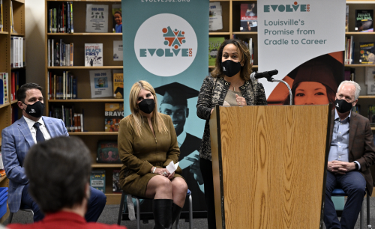
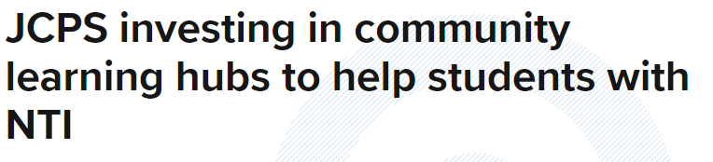
Source: Louisville Courier Journal
Notes:
See 2020 in timeline. Community Learning Hubs served young kids whose parents had to work or who needed an environment other than home for learning. Older kids became eligible for free secondary education. Older kids under a lot of pressure to take jobs, but got more applications than expected.

Slide 22


Results (2021)

Slide 23

Marland Cole on evolve502
VIDEO HERE

Slide 24
Marland Cole & Dr. Marty Pollio
Executive Director, Evolve502 Superintendendent JCPS
Notes:
Title Slide v1

Slide 25



Raymond
Burse
U of Louisville
David
Calzi
Community Foundation of Louisville
Heidi
Margulis
Humana
Mary
Gwen
Wheeler
Policy Consultant
Mary
Nixon
(Chair)
U of Louisville
Ryan Davis
JCPS Teacher
Supt. Marty
Pollio
Public Schools
Diane Porter
Board of Education
Mayor Greg Fischer
Metro Gov
Amanda Gehring
KY Health & Family
Services
.
Aaron
Thompson
KY Council on Postsecondary
Ed.
Larry Benz
Confluent Health
Pedro Bryant
Republic
Bank
Yvette Gentry
Rajon Rondo
Foundation
Evolve502 Board 2021
Tony Georges
UPS
Finance Committee
Governance Committee
Tess McNair
C.E. & S.
Foundation
Audwin Helton
15,000
Degrees
Mason Rummel
JG Brown
Foundation
Alice Houston
15,000
Degrees
Sadiqa Reynolds
Urban League
Scholarship Committee
Operating Committee
HR/Compensation Committee
Ankur Gopal Interapt
Autumn Neagle
15th District
PTA
Mark Lagestee YUM Brands
Steve Tarver
YMCA of
Greater
Louisville
Emilie Dyer
Americana
Community Center
Adria Johnson
Metro
United Way
Karina Barillas
La Casita
Center
Ty Handy
Jefferson Community and Tech. College
Kevin Cosby
U of
Louisville
Ryan Combs
U of
Louisville
Amy Lingo
U of
Louisville
Marian Vasser
U of
Louisville
Sarah Davasher-Wisdom
GLI
Tony Zipple
ARGI
Silverflux
Joe Reeves
ARGI
Financial
Group
Notes:
By the time the board was officially merged, there was a model in place for how to deliver services to elementary children through the Community Learning Hubs.

Slide 26
Cross-Sector Collaboration in Cities: Learning Journey or Blame Game? (forthcoming)
Pulido-Gomez et.al. R & R from Journal of Public Administration Research and Theory (JPART)
Question:
“What helps and hinders the design and management of CSCs in the longer term”
Methods:
- Study 9 CSCs across three cities and three policy areas
- (Group) interviews, document analysis, surveys, exercises
Findings:
- Formal structure is no predictor of success.
- Adaptable collaborations are more likely to succeed.
- Five key actions contribute to a virtuous learning cycle:
Build on prior relationships and social capital
Leverage a trusted individual/group as navigator
Engage the community in all stages
Use data to focus, learn, and improve
Invest in joint problem-solving
Notes:
Teaming to innovate makes all the sense in the world. Why is it so hard? What keeps people from initiating and/or succeeding?

Slide 27
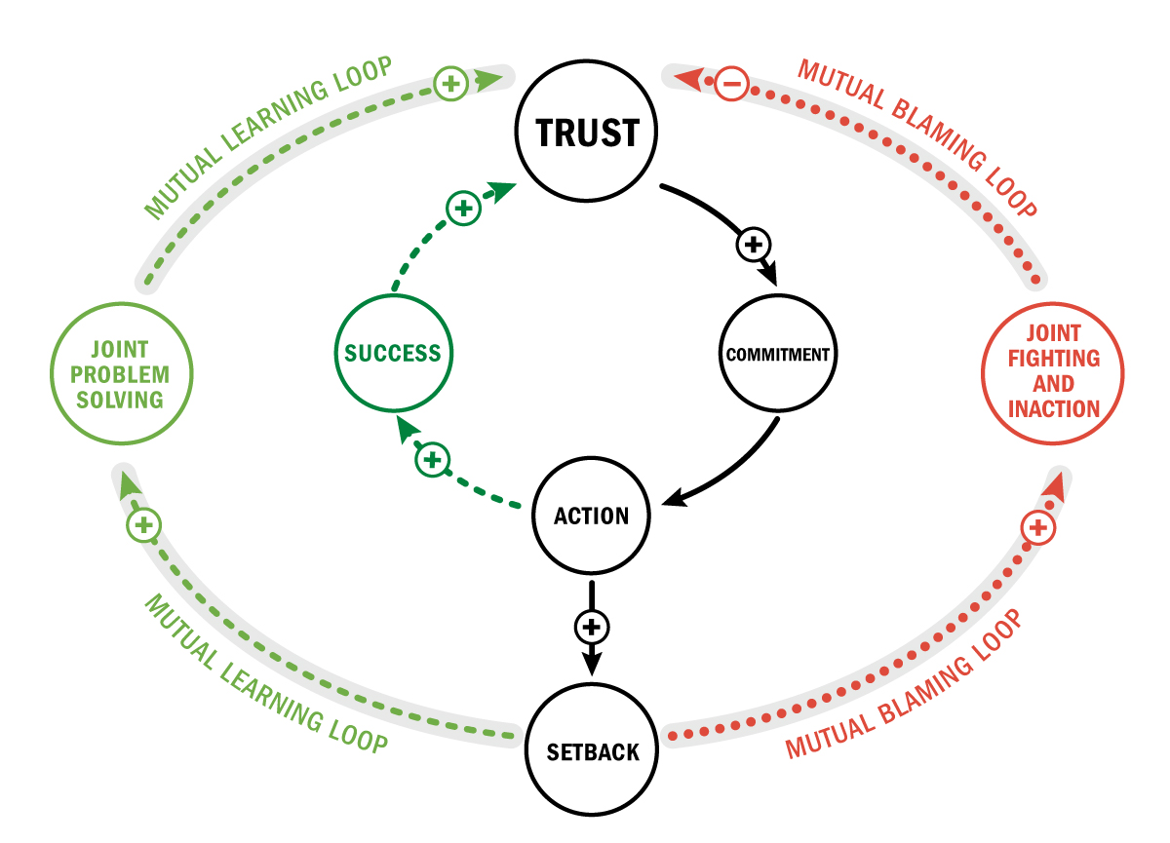
Learning Journey
or Blame Game?
Pulido Gomez, S., De Jong, J., and Rivkin, J. Learning Journey or Blame Game?
Cross-sector Collaboration in Cities, forthcoming publication.
Notes:
Content Slide v1

Slide 28
Learning Journey
or Blame Game?
Pulido Gomez, S., De Jong, J., and Rivkin, J. Learning Journey or Blame Game?
Cross-sector Collaboration in Cities, forthcoming publication.
Notes:
Louisville, Hartford

Slide 29
Learning Journey
or Blame Game?
Pulido Gomez, S., De Jong, J., and Rivkin, J. Learning Journey or Blame Game?
Cross-sector Collaboration in Cities, forthcoming publication.
Notes:
Content Slide v1

Slide 30
Learning Journey
or Blame Game?
Pulido Gomez, S., De Jong, J., and Rivkin, J. Learning Journey or Blame Game?
Cross-sector Collaboration in Cities, forthcoming publication.
Notes:
Content Slide v1

Slide 31
Learning Journey
or Blame Game?
Pulido Gomez, S., De Jong, J., and Rivkin, J. Learning Journey or Blame Game?
Cross-sector Collaboration in Cities, forthcoming publication.

Slide 32
Invest in Team Design and Launch
Acknowledge and address the common barriers
Task conflict does not have to be negative per se
Create conditions for learning, adaptation and growth as a team
Celebrate milestones and learn from what goes well
Learning Journey
or Blame Game?
Pulido Gomez, S., De Jong, J., and Rivkin, J. Learning Journey or Blame Game?
Cross-sector Collaboration in Cities, forthcoming publication.

Slide 33
Some Takeaways
Collaborating across boundaries is almost always hard. Acknowledge and address the common barriers and address them explicitly.
Adopt a both/and mindset: starting small and thinking big are not mutually exclusive. Find a suitable entry point and learn your way forward.
Don’t lock yourself into a structure. Invest in the ability to learn and adapt along the way. When there is a problem, solve it together.

Slide 34

Notes:
End Slide v1

